Slide 1
Angular Application on Git Hub

Slide 2
Project Implementation
You need to create single repository in Git Hub which will have all your assignments belongs to different sections of each phase
Name the repository so that its easy to recognize who you are during evaluation like “your_id_your_name_course”
Hint: 1234_james_mean_stack

Slide 3
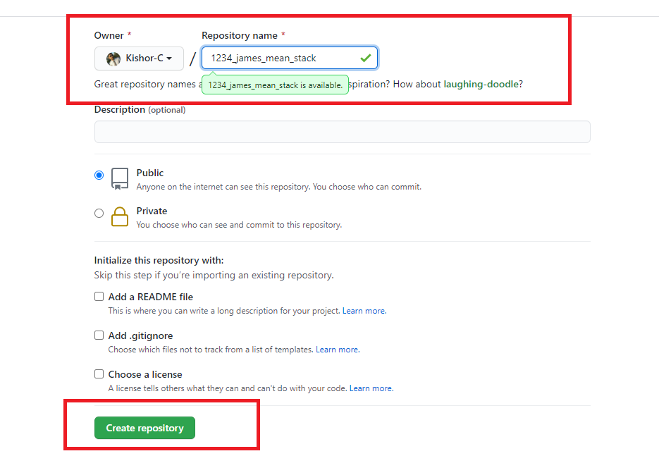
Project Implementation

Slide 4
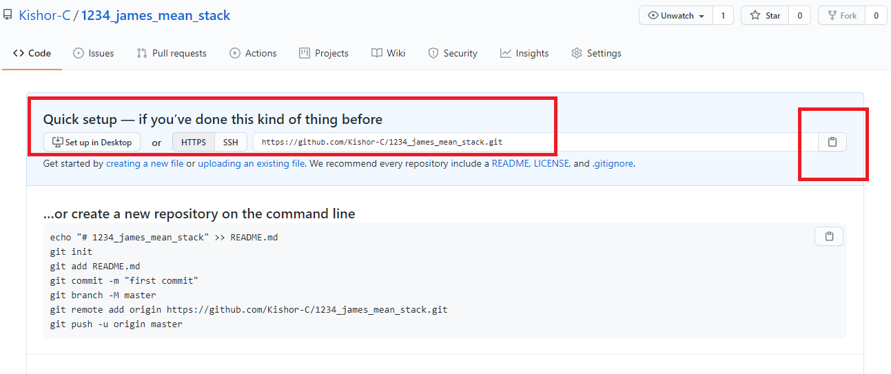
Project Implementation
Once you create the repository clone to your local machine
Use the command ‘git clone <repo-url>’

Slide 5
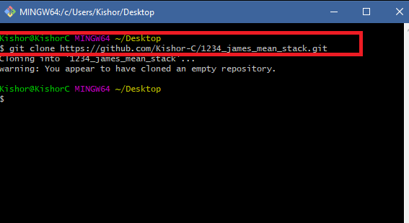
Project Implementation
Cloning into your local machine

Slide 6
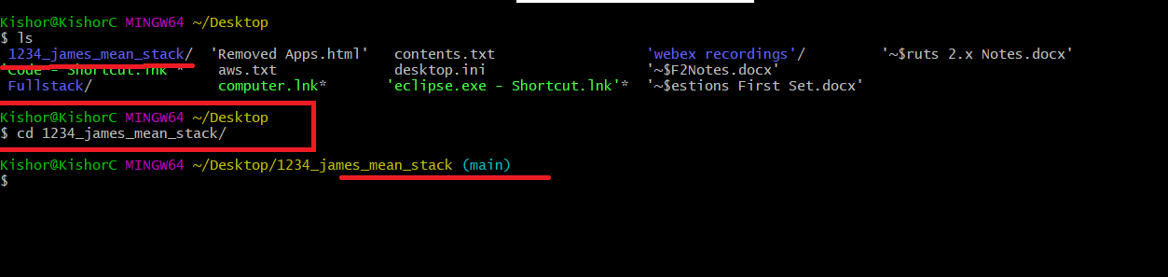
Project Implementation
Locate the cloned repository using ‘ls’ and get inside it using ‘cd’ commands

Slide 7
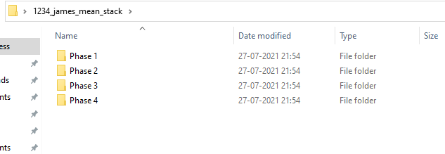
Project Implementation
Create 4 folders for all the phases as below

Slide 8
Project Implementation
Since for every phase you have to do section end projects & phase end project you will need to create projects as per the phase number
Ex: Angular Application on Git Hub is part of Phase 1 so create that project in the Phase 1

Slide 9
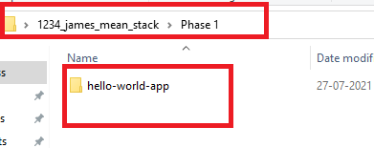
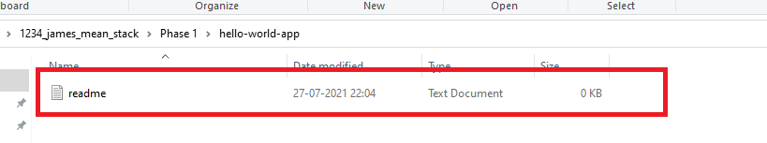
Project Implementation
This is the first project you need to create to understand the GIT hence you need to push only an empty folder with any dummy file inside the folder, file need not to have any content

Slide 10
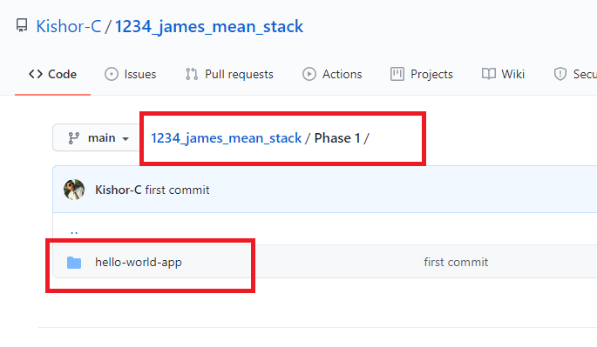
Project Implementation
Push the project to your remote repository using appropriate commands and ensure its updated in the remote as below

Slide 11
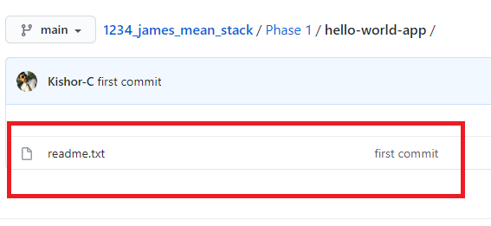
Project Implementation
Push the project to your remote repository using appropriate commands and ensure its updated in the remote as below

Slide 12
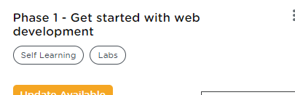
Project Submission Steps
Login to LMS and go to your course
Full Stack Web Developer - MEAN Stack
Select Phase 1- Get started with web development

Slide 13
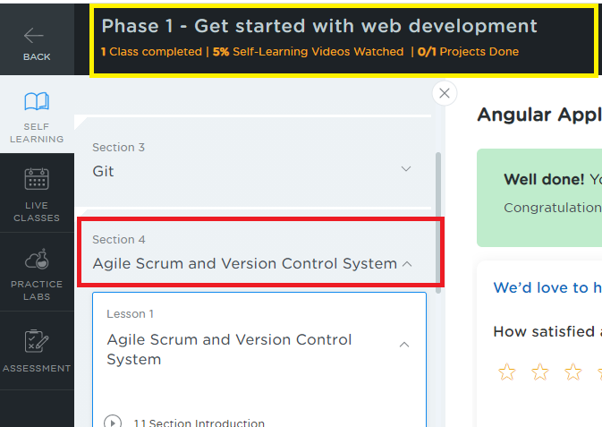
Project Submission Steps
Choose self learning and scroll down to Section 4 Agile Scrum and Version Control System

Slide 14
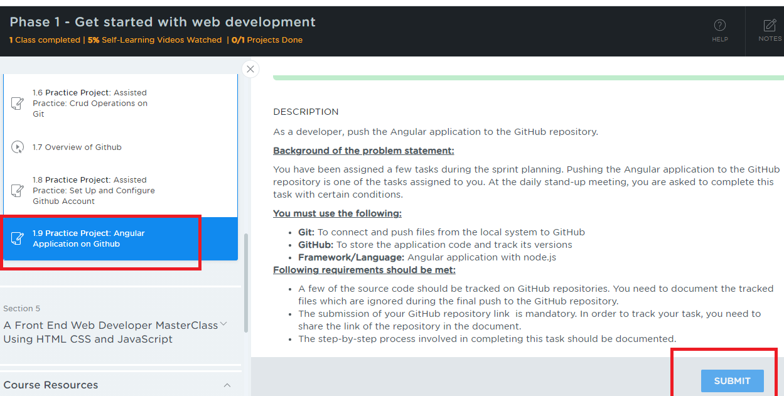
Project Submission Steps
Choose section 4, click lesson 1 and scroll down to the sub-section 1.9 which has a Practice Project – Angular Application on Git Hub, click on it you will see the description and submit button

Slide 15
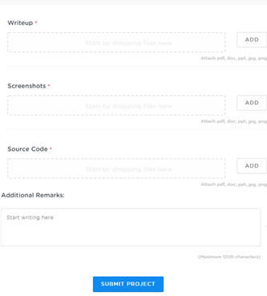
Project Submission Steps
After you click on submit you will get a window as below
Things to submit:
Writeup:
Upload a word document that will have the Git repository link so that from the LMS we can download this document to find your git repository
Give a brief explanation about your project and the files & folders we need to look into so that it is easy to locate.
Screenshots:
Upload the files that will have screenshots of the output
Source Code:
Upload the Zip files that will have all your source code files, if in case you face problem in attaching the zip, you can attach the source code files one by one
Additional Remarks:
Mention some remarks if required

Slide 16
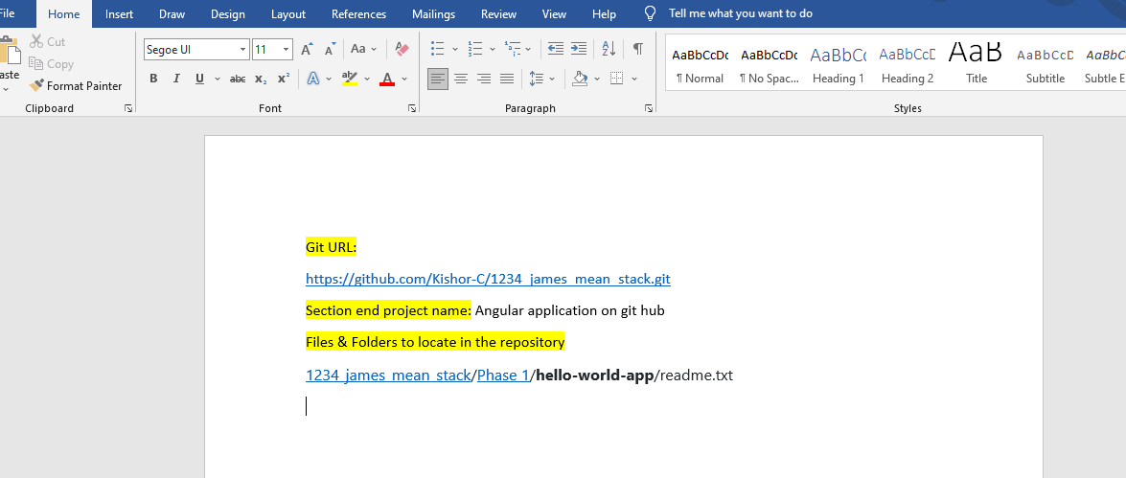
Project Submission Steps
Sample write up document

